Slide 1

Neural Network Deep Learning
Ahmed Tolba

Slide 2
Neural Network Design
Choose the right design
Define initial theta values
01
02
Forward propagation
Back propagation
03
04
05
Update Weights

Slide 3
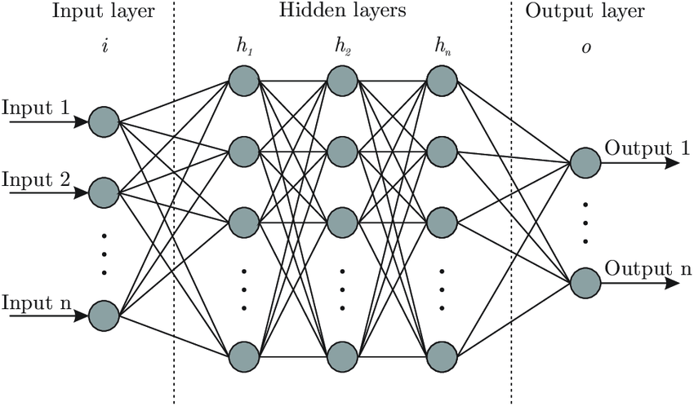
Choose the right Design
1 - Determine the number of layers, and the number of neurons of each layer
2 - The input layer must have the number of neurons identical to the number of features.
3 - The output layer must be the number of neurons in it identical to the number of classification options
Required .

Slide 4
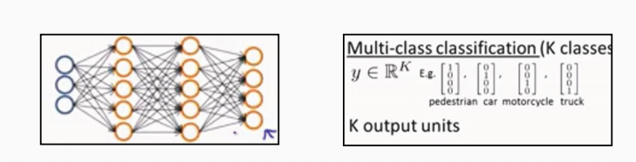
Choose the right Design
4- As the number of hidden layers increases, the quality and efficiency of the network increases, and the time required for it increases
5 - The number of cells for the hidden layers must be greater than the number of the features entries
Notes :
In the case of more than one classification, all values are zero, except for the expected value

Slide 5
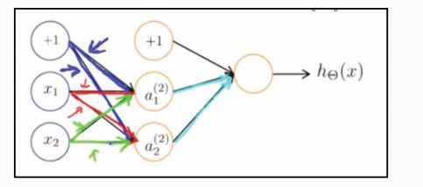
Define initial theta values
1 - NN, you cannot choose zeros as the default values for the theta.
When this happens
It will destroy the network immediately, because it will make all the output layers equal and will never change
3 - The numbers often range
(0.001 , -0.001)

Slide 6
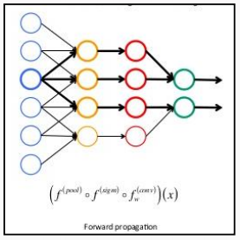
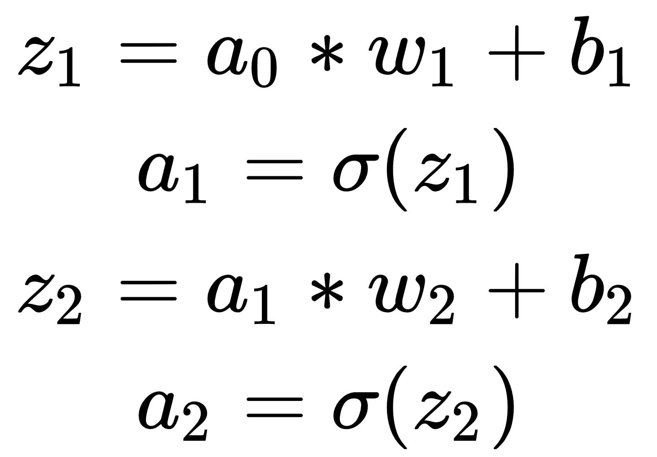
Forward propagation
The y (a) output is calculated
From the input exe.
The output is calculated by the sigmoid function to calculate the expected value

Slide 7
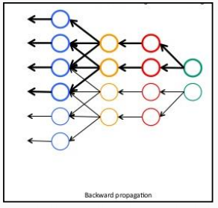
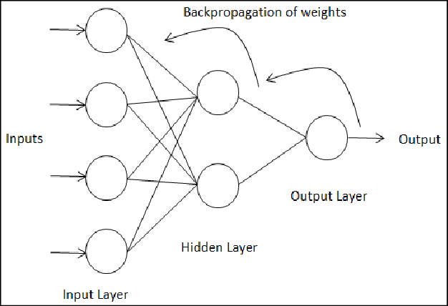
Back propagation
This is done using finding the difference between the expected value, the real value and the derivative of theta.

Slide 8
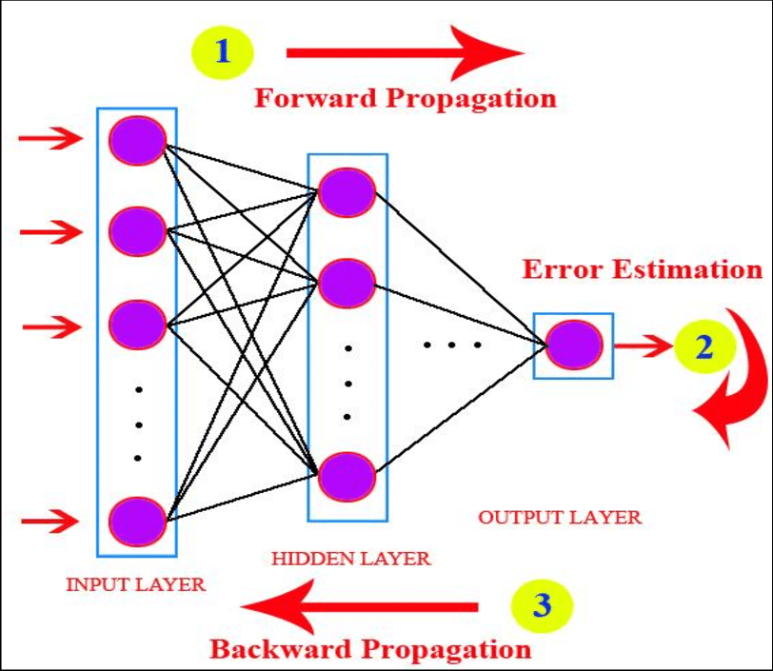
Update Weights
Repeate Forward and Back Propagation number of iteration to get best weights

